Slide 1

Advanced sentiment analysis in Movie reviews(Extended spotlight)
HEMANTH TIPIRNENI

Slide 2
Problem:
Analyzing Sentiment in Movie Reviews
Primary Goal:
"To develop a sentiment analysis model that predicts the sentiment (positive or negative) of movie reviews based on textual content."
The dataset comprises textual reviews of movies along with corresponding sentiment labels.
The project aims to build a model that can effectively analyze the sentiment expressed in these reviews.
The goal is to create a predictive model that, given a new movie review, can classify it as either positive or negative based on the language used in the text.

Slide 3
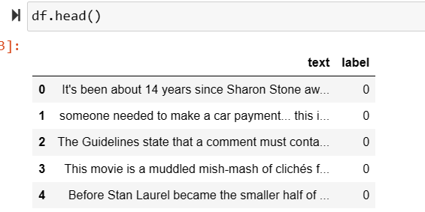
Data Loading
Loaded the data using pandas
data = pd.read_csv(“feedback.csv")
Data.head()

Slide 4
Overview of Dataset
Dataset Overview:
5000 entries in total.
Indexed from 0 to 4999.
Data Columns:
Column 1: 'text'
Contains textual data (reviews, comments, etc.).
Dtype: Object (string).
Column 2: 'label'
Represents sentiment labels.
Dtype: Integer (0 for negative sentiment, 1 for positive sentiment).

Slide 5
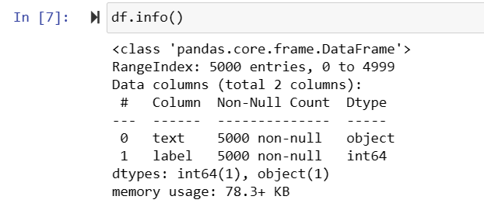
Data Information
Data pre-processing
data.info()
Used Clean Transformer for cleaning data.
Converted to lower case
Removed html tags
Remove non-alphanumeric characters
Removed extra white spaces

Slide 6
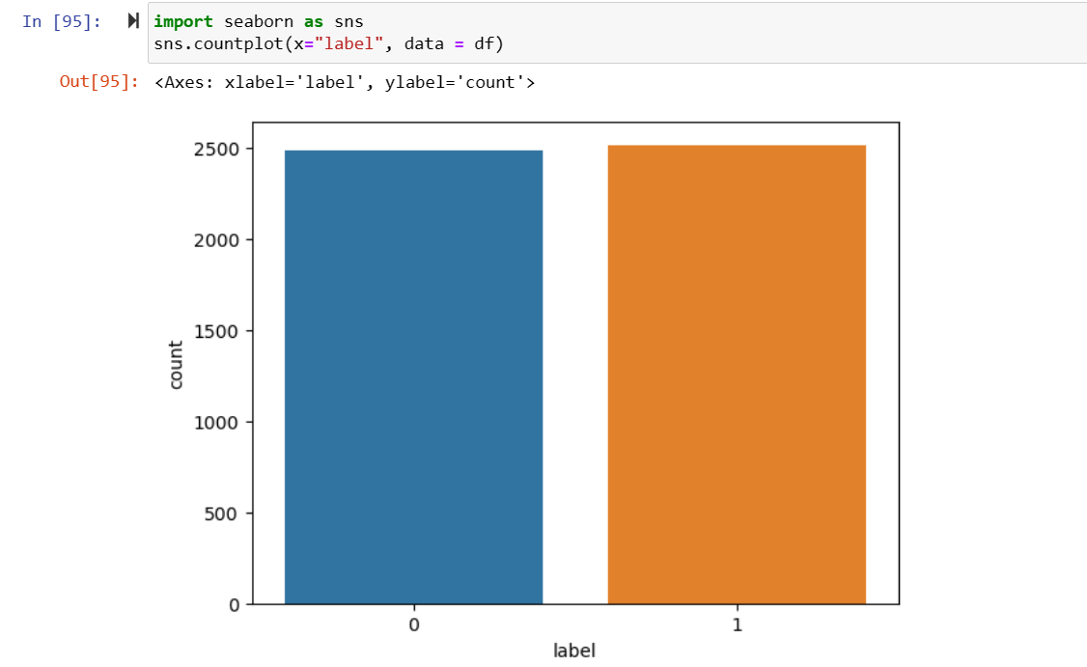
Describing Data visualization using Seaborn
Countplot of the “label" variable
sns.countplot(x=“label", data=df)

Slide 7
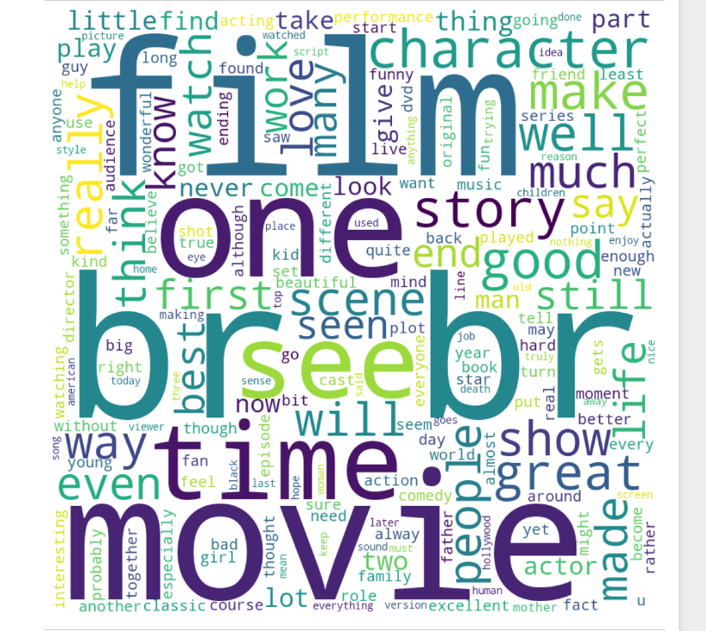
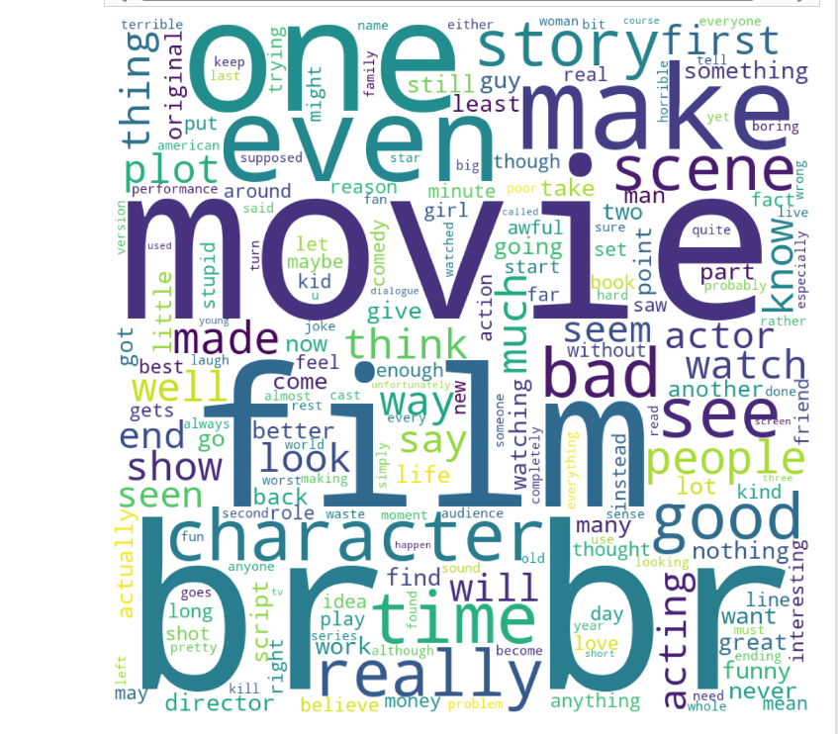

Slide 8
Feature Extraction with CountVectorizer
Introduction:
In our journey to understand sentiments encoded in text, we need a way to represent words numerically. This is where feature extraction comes into play.
What is CountVectorizer?
CountVectorizer is a tool from the scikit-learn library that helps us convert a collection of text documents into a numerical format.
We now have a numerical representation of our text data, ready to be fed into machine learning models for sentiment analysis

Slide 9
Data Splitting for Model Training
Now that we have our text data numerically represented, the next crucial step is to split our dataset into training and testing sets.
Why Splitting Data?
We split the data to train our machine learning models on one portion and evaluate their performance on another. This helps us assess how well our models generalize to new, unseen data.
Why 33%?
The choice of the test size can vary, but 33% is a common split to strike a balance between having enough data for training and a sufficiently large test set for evaluation.
We've divided our dataset into training and testing sets, with 33% of the data reserved for testing. This ensures an unbiased evaluation of our models. Next Steps:
With our data split, we're ready to train our models on the training set and evaluate their performance on the testing set.

Slide 10


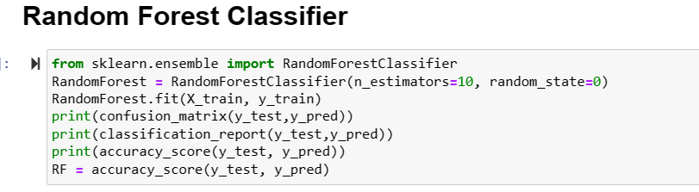
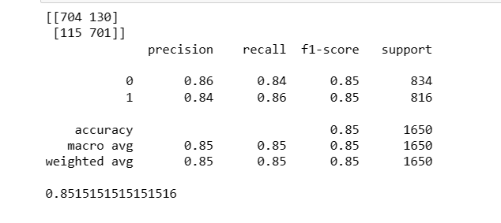

Slide 11
704 True Negatives (TN): The model correctly predicted 704 instances as negative.
701 True Positives (TP): The model correctly predicted 701 instances as positive.
130 False Positives (FP): The model incorrectly predicted 130 instances as positive when they were negative.
115 False Negatives (FN): The model incorrectly predicted 115 instances as negative when they were positive.
The Random Forest Classifier demonstrates good performance with balanced precision, recall, and accuracy. However, further analysis and comparison with other models will help determine the best approach for our sentiment analysis task.

Slide 12

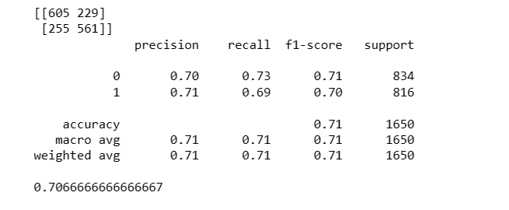
Decision tree
.

Slide 13
The Decision Tree Classifier shows moderate performance, with a balanced precision, recall, and accuracy. Further comparison with other models will help in selecting the most suitable approach for our sentiment analysis task.
The overall accuracy of the Decision Tree model is approximately 70.67%. This represents the percentage of correctly classified instances over the total.

Slide 14
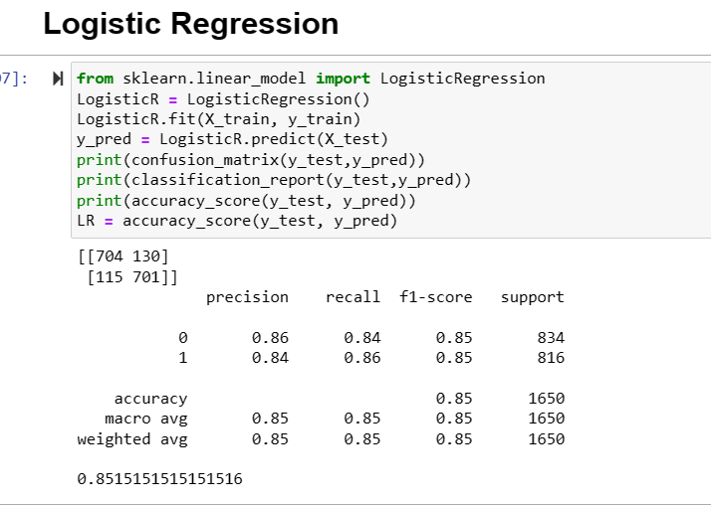
Logistic regression

Slide 15
Logistic regression
The overall accuracy of the Logistic Regression model is approximately 85.15%. This represents the percentage of correctly classified instances over the total.
Conclusion:
The Logistic Regression model demonstrates strong performance, with high precision, recall, and accuracy. It outperforms the Decision Tree model, suggesting its effectiveness in sentiment analysis for this dataset.

Slide 16
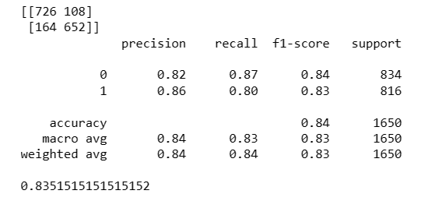
Multinominal Naïve Bayes
The Multinomial Naive Bayes model demonstrates robust performance, with high precision, recall, and accuracy. Its F1-Score indicates a balanced trade-off between precision and recall, making it suitable for sentiment analysis in this dataset.
The overall accuracy of the Multinomial Naive Bayes model is approximately 83.52%. This represents the percentage of correctly classified instances over the total.

Slide 17
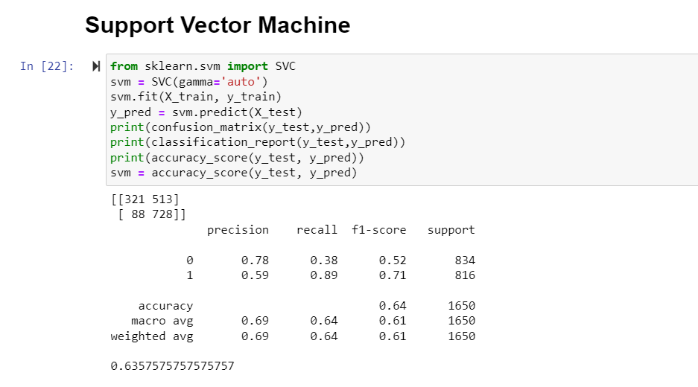

Slide 18
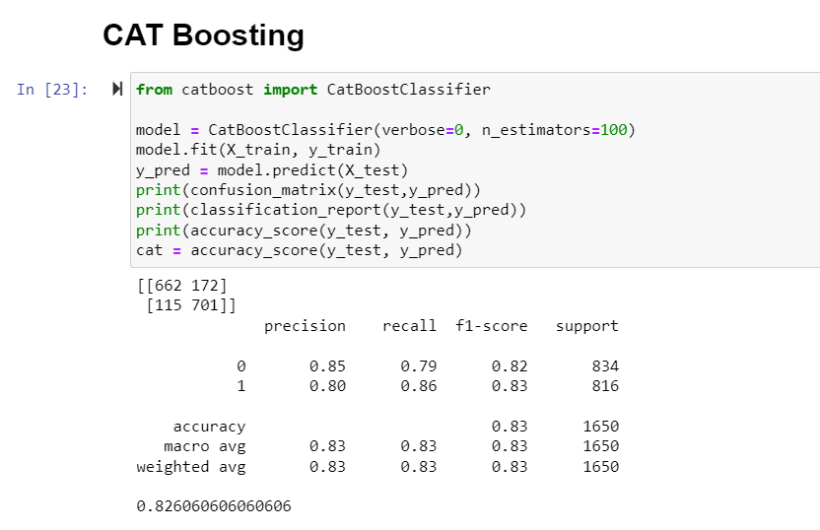

Slide 19
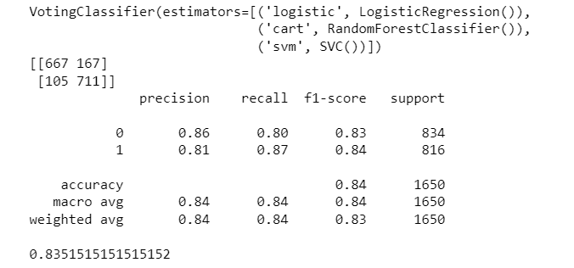

Slide 20

Deep Learning
Data preprocessing:
"In such preprocessing stage, the 'text' column in a data frame is changed by using A cleaning function to improve data quality as well as prepare it over further analysis.“
Recognize the maximum possible sentence length within the provided text data.
This is useful information for text processing as well as model input shaping.
Maximum sentence length: 6356 characters

Slide 21
Data is divided into sets for training and validation.
Using "stratify" throughout splitting to address an imbalanced distribution.
Tokenization: Use Tokenizer via a maximum word count of 5000.
Understanding the scope of the vocabulary.
Creating sequences from text data for model input.
Sequences are padded to an appropriate length for uniformity.
Results:
Training set shape: (4000, 100)
Validation set shape: (1000, 100)
Total unique words: 45474
Word Dictionary:
Creating a dictionary mapping words to numerical indices.

Slide 22
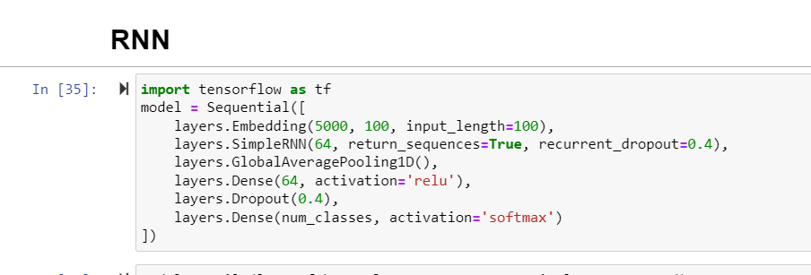
RNN Model Training
For text classification, we created a neural network architecture using TensorFlow's Keras API.
The model takes integer-encoded word sequences as input and converts them into dense vectors using an algorithm.
Embedding layer,
SimpleRNN layer
The GlobalAveragePooling1D
The subsequent dense layers

Slide 23
The compile method is used to specify the loss function, optimizer, and evaluation metric(s) for the model.
The model is then trained using the fit method with the provided training data (X_train, y_train).
The training lasts 10 epochs, and the validation results (X_val, y_val) are used to evaluate the model's performance after each epoch.
To avoid the algorithm from learning the logical sequence of the examples, the shuffle=True parameter guarantees the training data is at random shuffled before each epoch.

Slide 24
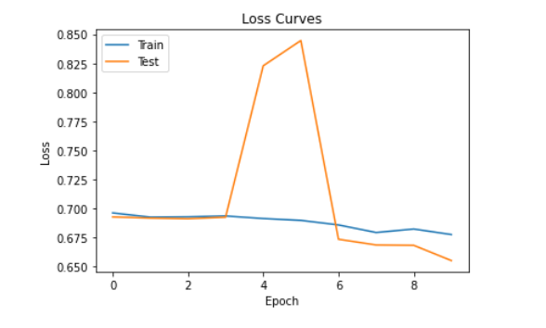
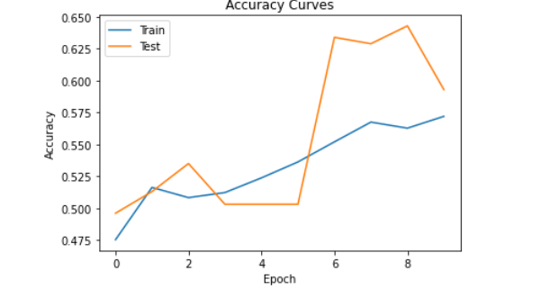

Slide 25
CNN
Embedding Layer
Convolutional and Max Pooling Layers
Flatten Layer:
Dense (Fully Connected) Layers:Two dense layers with 1024 and 512 units, respectively.Activation function: ReLU for non-linearity.
Output Layer:Produces final predictions.Units: Equal to the number of classes.Activation: Softmax for normalized probabilities.
Optimizer and Compilation:Adam optimizer with a specified learning rate and beta values.
Loss Function: Sparse categorical crossentropy for multiclass classification.

Slide 26
Model Initialization:
Creation of a Convolutional Neural Network (CNN) model.
Utilizes an embedding layer, convolutional layers, pooling layers, dense layers, and an output layer.
Training Process:
Training the model on the provided training data.
Configuration:
Number of epochs: 10.
Data shuffling during training for randomness.
Training and validation are crucial steps in optimizing model performance.
Monitoring metrics helps assess the model's ability to generalize

Slide 27
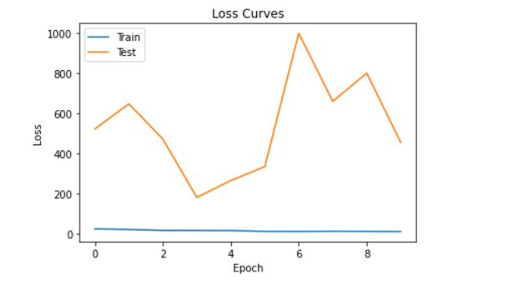
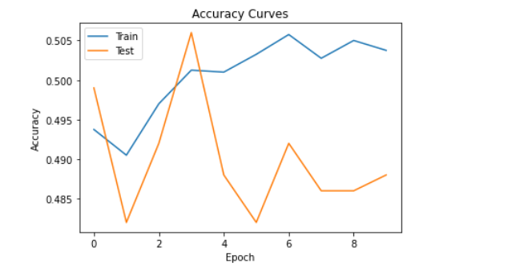

Slide 28
LSTM
Preparing the data for sentiment analysis using LSTM (Long Short-Term Memory) models.
Parameter Settings:
num_words: 15,000 words in the dictionary.
val_size: Validation set size of 1,000.
epochs: Training for 20 epochs.
batch_size: Mini-batch gradient descent with a batch size of 512.
Data Preprocessing:
Tokenization:
Each document in the dataset (tweets) is tokenized into arrays of words. Tokenization ensures that words are represented as numerical values for model input.
The tokenized words are appended to form documents (docs).This step prepares the textual data for further processing and model training.
Stopwords and Punctuation Handling:
Removal of common English stopwords and punctuation.
Special consideration for negations like "not," "n't," and "no.“

Slide 29
Part-of-Speech (POS) Tagging:
Mapping POS tags to WordNet categories (ADJ, VERB, NOUN, ADV) for lemmatization.
Removed stopwords and punctuations and lemmatize each document
Each document's words are cleaned, lemmatized, and transformed into a cleaned string.
Using tokenizers to create the tokens having no of words=15000(num_words)
Complete data is tokenized to vectors and padding is done using zeros to match its length to the largest text in the dataset

Slide 30
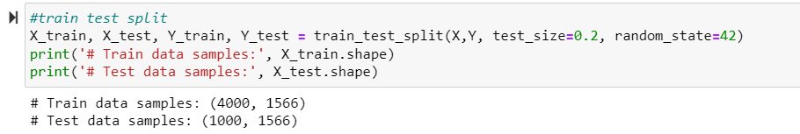
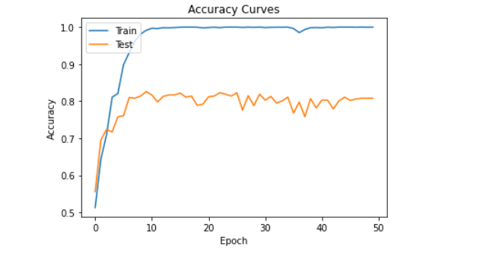
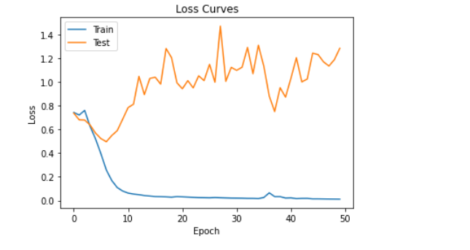
Saved the Keras Tokenizer object, used for text preprocessing, into a pickle file named 'transform2.pkl' for future use.
Test accuracy of lstm model: 80.30%

Slide 31
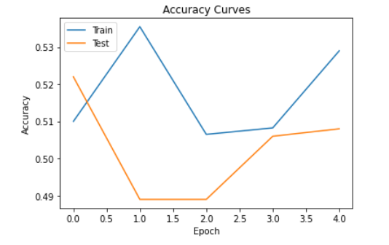
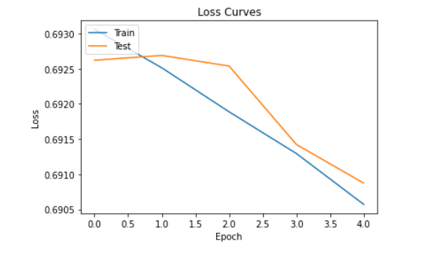
DNN

Slide 32
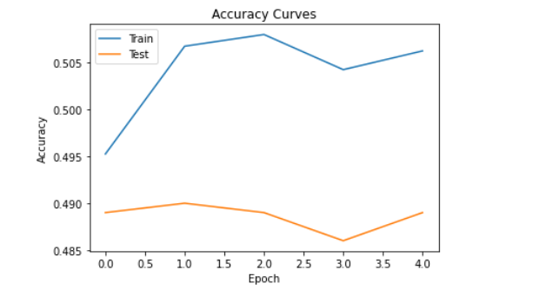
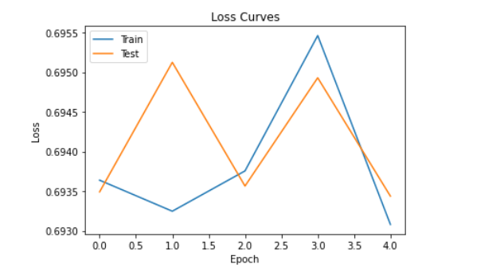
Cnn+lstm

Slide 33
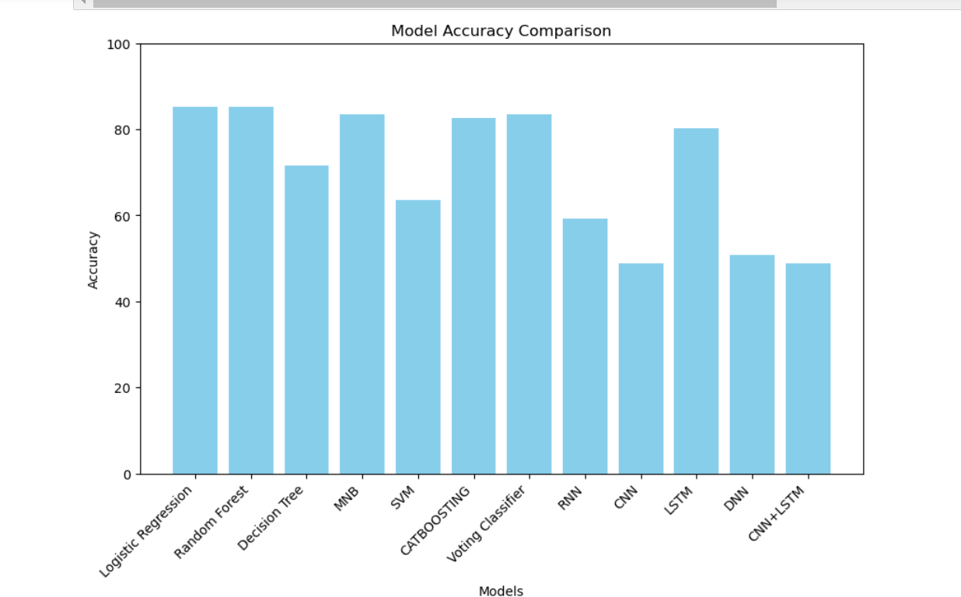

Slide 34
THANK YOU

